Slide 1
Order Buddy - Speech to Text Order Assistant
Aanchal Anil Samdariya
Apoorva Kasoju
Karan Gulur Muralidhar
Kanuparti Krishna Sai Rohith

Slide 2
AGENDA
PROBLEM STATEMENT
HIGH LEVEL ARCHITECTURE
ASSUMPTIONS
DEMO
KEY COMPONENTS
STATE TRANSITIONS
INTENT
PRELIMINARY RESULTS
FURTHER ENHANCEMENTS

Slide 3

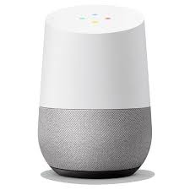

PROBLEM STATEMENT
ORDER BUDDY
OB: Hey there! What do you want to order?
Cust: I want a Mocha Latte.
OB: Got it, one Mocha Latte, Do you want to customize this item?
Cust: Can you add extra sugar please
OB: Got it, one Mocha Latte with extra sugar.Do you want to order anything else?
Cust: No.
OB: Order Confirmed, have a good day!

Slide 4
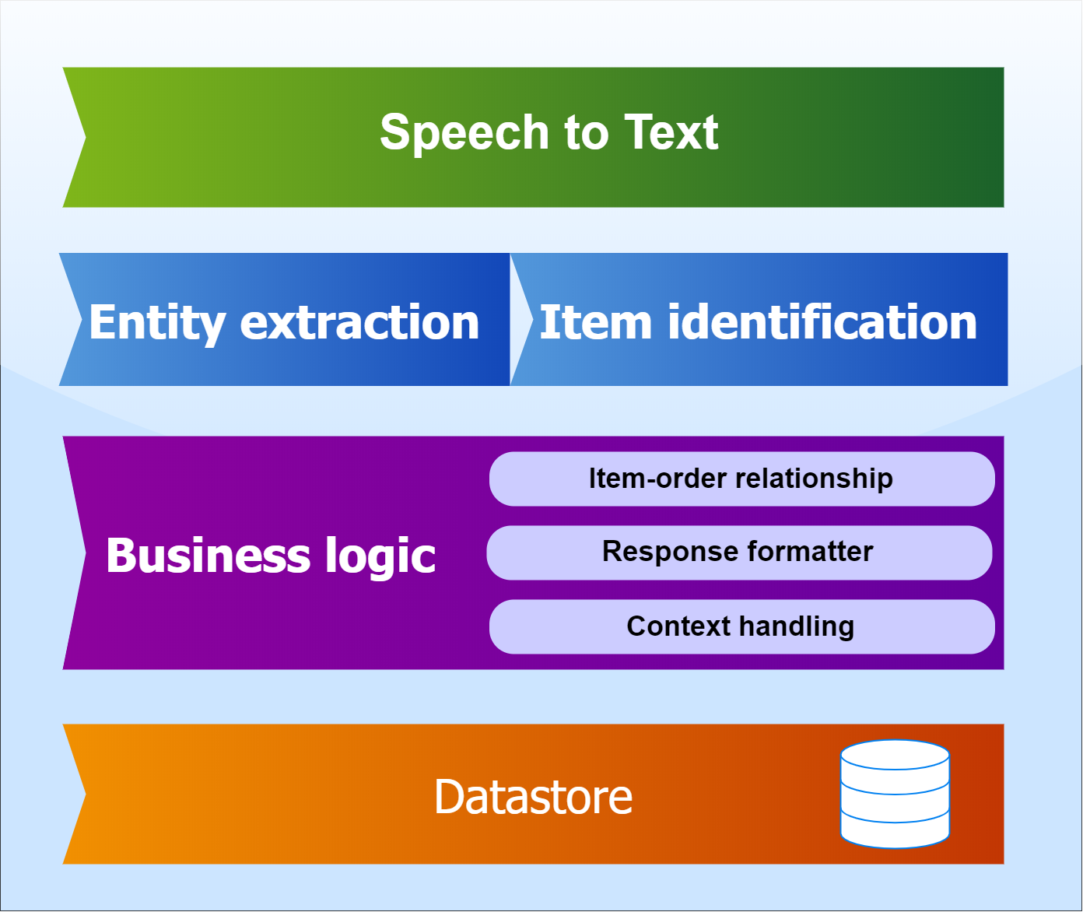
HIGH LEVEL ARCHITECTURE

Slide 5
ASSUMPTIONS
Support - order item, cancel item, cancel order and complete order.
A order can comprise of multiple items.
An utterance can only have one item at a time.
Certain intents have reserved phrases.

Slide 6
DEMO
Small Coffee
Large Cafe Latte
Large Coffee - DELETE

Slide 7
KEY COMPONENTS
Agent: An interface to handle conversations with end-users.

Slide 8
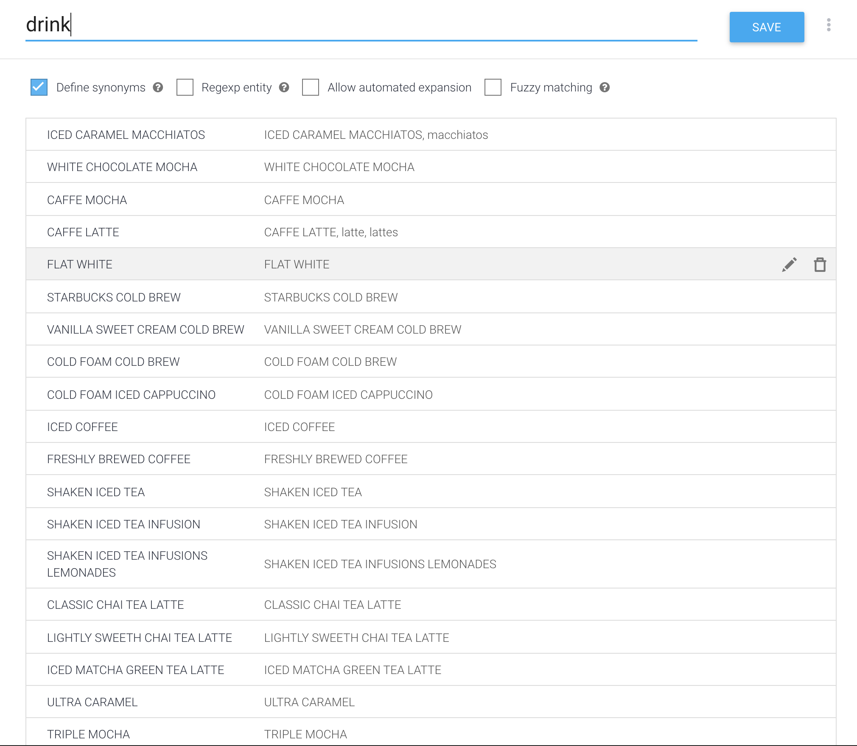
Entity: A definition to extract informations from end user expression

Slide 9
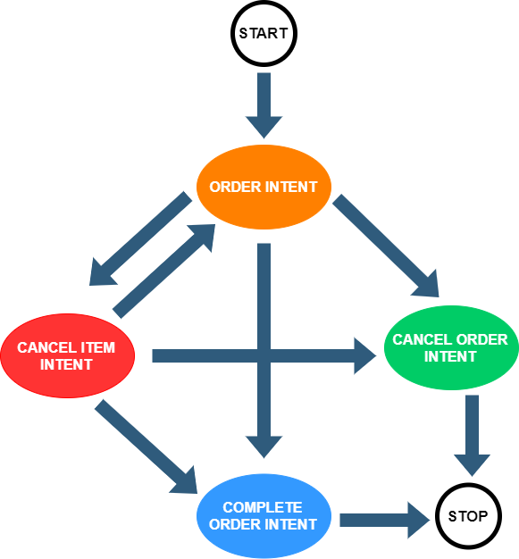
Intent: A mode to understand user intentions in utterance

Slide 10
KEY COMPONENTS
Agent: An interface to handle conversations with end-users.
Entity: A definition to extract informations from end user expression.
Intent: A mode to understand user intentions in utterance.
Reserved Phrases
Slot Filling: Procedure to handle required parameters in an utterance.
Context: Parameters storing current state of utterance.
Fulfillment: A mechanism to integrate with external code.

Slide 11

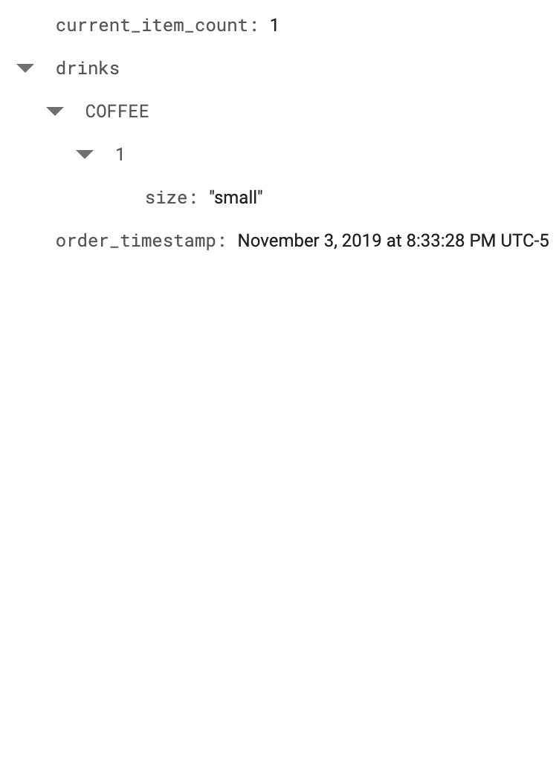
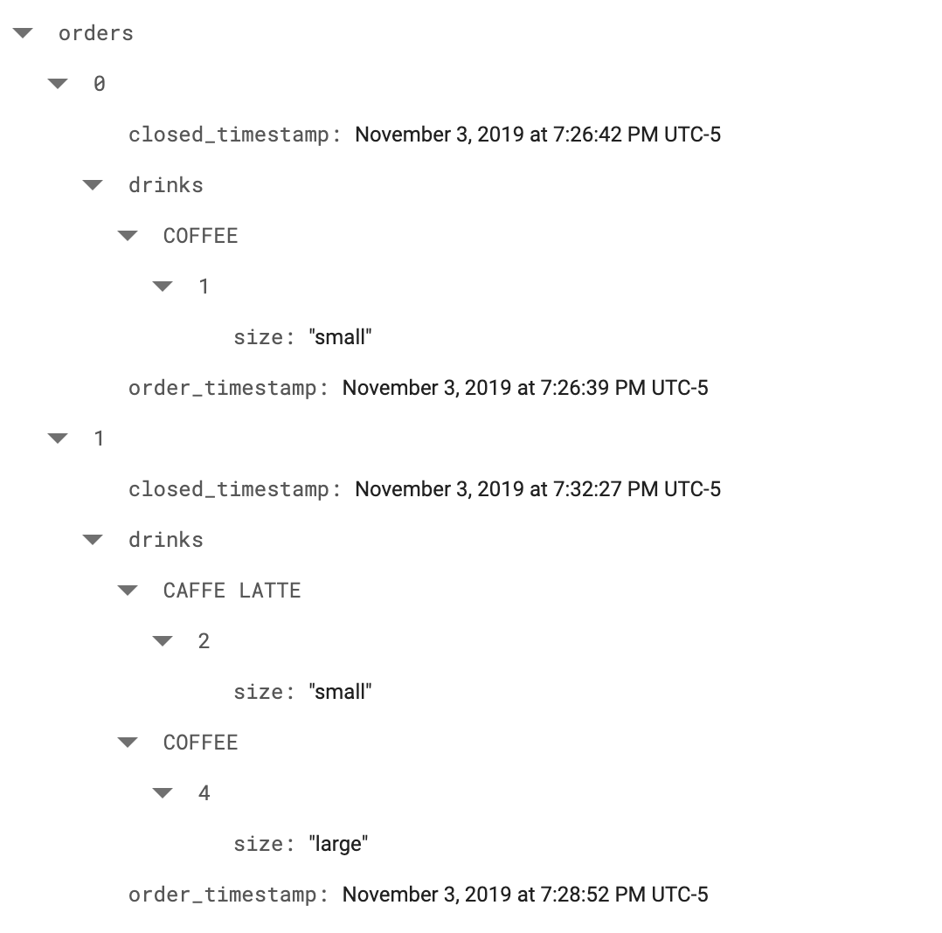
DATASTORE
CURRENT ORDER HISTORY

Slide 12
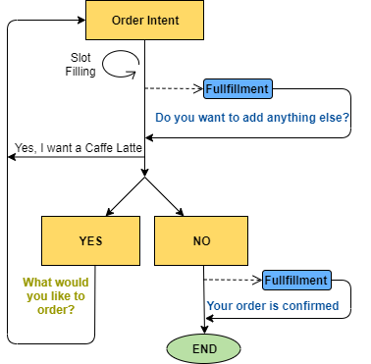
ORDER INTENT
NAME: order_intent
SAMPLE UTTERANCE: Can I have a large coffee?
REQUIRED PARAMETERS: Drink, Size
FULFILLMENT: YES
FOLLOW UP INTENTS:
order_intent.yes
SAMPLE UTTERANCE: Why not?
order_intent.no
SAMPLE UTTERANCE: Nah I’m good.
FULFILLMENT: YES

Slide 13
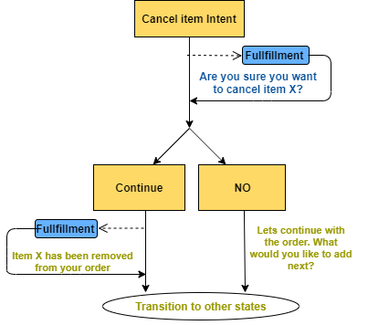
CANCEL ITEM INTENT
NAME: cancel_item_intent
SAMPLE UTTERANCE: Delete this item?
FULFILLMENT: YES
FOLLOW UP INTENTS:
cancel_item_intent.continue
SAMPLE UTTERANCE: Remove Item 4
FULFILLMENT: YES
cancel_item_intent.no
SAMPLE UTTERANCE: No.
USE CASES:
Delete this item
Can you remove Cafe Latte?

Slide 14
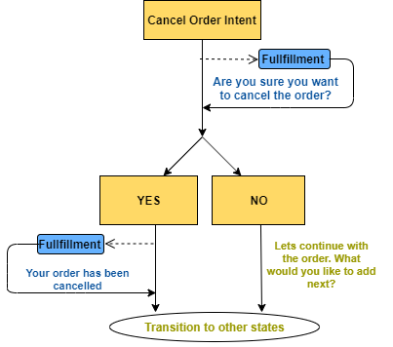
CANCEL ORDER INTENT
NAME: cancel_order_intent
SAMPLE UTTERANCE: ABORT , EXIT
FULFILLMENT: YES
FOLLOW UP INTENTS:
cancel_order_intent.yes
SAMPLE UTTERANCE: Yes
FULFILLMENT: YES
cancel_order_intent.no
SAMPLE UTTERANCE: No

Slide 15
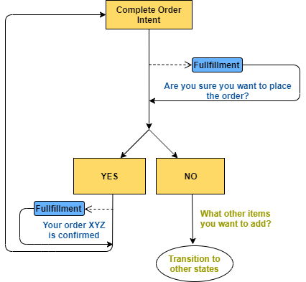
COMPLETE ORDER INTENT
NAME: complete_order_intent
SAMPLE UTTERANCE: COMPLETE ORDER
FULFILLMENT: YES
FOLLOW UP INTENTS:
complete_order_intent.yes
SAMPLE UTTERANCE: Yes
FULFILLMENT: YES
complete_order_intent.no
SAMPLE UTTERANCE: No

Slide 16
FURTHER ENHANCEMENTS
Multiple Items, Modify Intent(adding customization), Training Improvement for Intents, Response beautification.
Evaluation for entities, intents.
Integration with Google Assistant, Phone, Facebook messenger etc…
Support for multiple restaurants.
Menu - Image to Text(Optical Character Recognition).
Analytical API’s for restaurants.

Slide 17
THANK YOU

